Slide 1
Using Academic Progress Monitoring for Individualized Instructional Planning and Goal Setting in Mathematics
Notes:
Introduction to the Module
This module was adapted from a series of training modules developed by the National Center on Intensive Intervention (NCII) and is aimed at district or school teams involved in the initial planning for using data-based individualization (DBI) as a framework for providing intensive intervention in academics and behavior. The audience for this module may include school teams supporting academic intervention and progress monitoring in mathematics. Team members may include interventionists, special educators, school psychologists, counselors, and administrators, as appropriate. It is assumed that the audience already has some knowledge of progress monitoring.
Instructions for Using the Speaker Notes
Text formatted in standard font is intended to be read aloud or paraphrased by the facilitator.
Text formatted in bold is excerpted directly from the presentation slides.
Text formatted in italics is intended as directions or notes for the facilitator; italicized text is not meant to be read aloud.
Text formatted in underline indicates an appropriate time to click to bring up the next stage of animation in an animated slide.
Speaker Notes for Title Slide
Recommended presentation resources:
An internet connection is preferred for live demonstration of the Tools Chart (slides 21–23); it is required for the activity on slide 27.
Participants should have pen and paper for the activities (see slides 27 and 69).
Printouts of “Handout 1: Academic Progress Monitoring Overview” as a summary and “Handout 2: Setting a Goal for Andrew” for the group activity (see slide 69).
Welcome participants to the training. Introduce yourself (or selves) as the facilitator(s) and briefly cite your professional experience in regard to progress monitoring and intensive academic intervention.
Today’s presentation draws some materials from the National Center on Response to Intervention’s (NCRTI) RTI Implementer Series Module 2: Progress Monitoring. For a more complete introduction to progress monitoring, this module can be accessed online (National Center on Response to Intervention, 2012).
Although permission to reprint this publication is not necessary, the citation should be as follows: i3 Intensive Intervention in Mathematics. (2019). Using academic progress monitoring for individualized instructional planning and goal setting in mathematics. Washington, DC: American Institutes for Research.

Slide 2
Learning Objectives
By the end of today, participants will:
Understand the purpose of using different mathematics progress monitoring tools.
Access resources to identify appropriate, potential progress monitoring tools.
Be able to use progress monitoring data to:
  Determine ways to set individualized goals for intervention or for individualized education plans (IEPs).
  Decide when instructional changes are needed for individual students.
Notes:
The learning objectives for this training are as follows:
Read bulleted points on slide to participants.

Slide 3
Progress Monitoring:
A Quick Review of the Basics
How does it fit into the data-based individualization (DBI) process?
Notes:
The purpose of this section is to review the key elements of progress monitoring (for some), explain how progress monitoring fits into the DBI process, and make sure we are all on the same page as we move on to implementation issues.

Slide 4
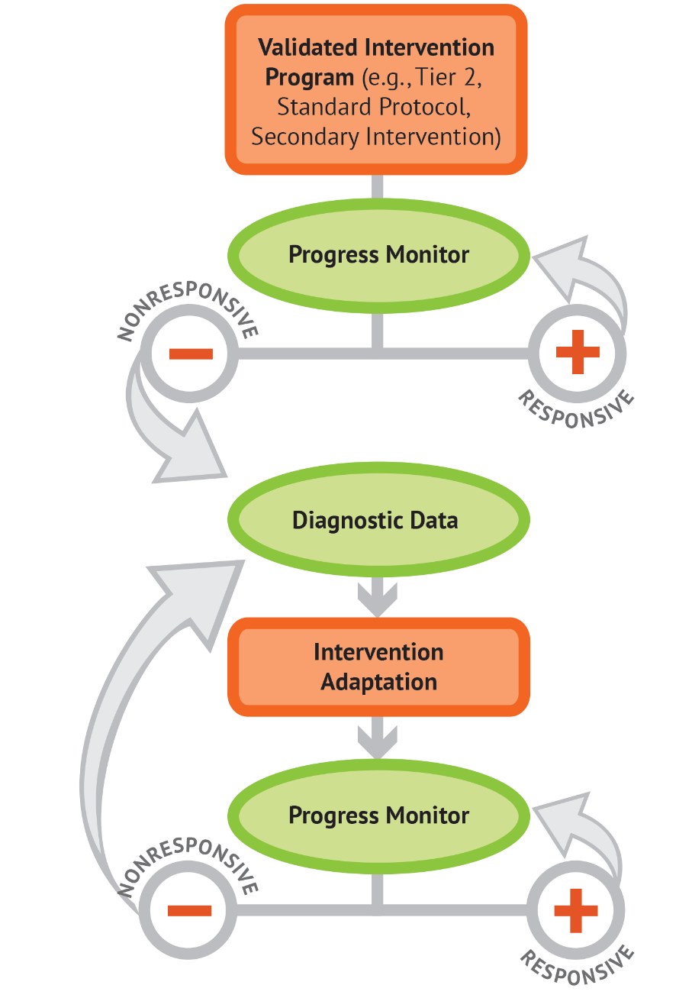
Quick Review: DBI Process
Notes:
Animated slide—click where underlined text appears to bring up arrows.
In the past, you may have used progress monitoring data to make group intervention decisions, but today we are focusing on how progress monitoring is used to inform instructional decisions for individual students within the DBI process. The same progress monitoring data that tell us a student is not responding to core instruction may also tell us that secondary intervention is not sufficient to help the student reach his or her academic goal. After the intervention has been adapted, we continue progress monitoring to determine if the changes have been sufficient or if we need to make additional changes.
A more complete overview of the DBI process is available in the introductory module that is available on the NCII website.

Slide 5
Types of Assessment
Type | When? | Why?
Summative | After | Assessment of Learning
Diagnostic | Before | Identify skill strengths and weakness
Formative | During | Assessment for Learning
Notes:
Animated slide—click on underlined text to circle Formative row.
Before we delve into progress monitoring assessments, it may be helpful to discuss the different kinds of assessments and how they are used.
Summative assessments are typically administered after instruction and tell us what a student learned (e.g., end-of-chapter tests, high-stakes tests, final exams).
Diagnostic assessments measure current knowledge and skills for the purpose of planning instruction (e.g., what to teach, selecting an intervention).
Formative assessments are administered during instruction and tell us how well students are responding to instruction (e.g., mastery measures, general outcome measures).
Progress monitoring is a standardized method of formative assessment.

Slide 6
Formative or Summative?
Educational researcher Robert Stake used the following analogy to explain the difference between formative and summative assessment:
“When the cook tastes the soup, that’s formative.
When the guests taste the soup, that’s summative.”
(Scriven, 1991, p. 169)
Notes:
Read slide.

Slide 7
Assessments in Your School
Take 5 minutes and discuss with your team:
What is an example of a summative assessment used in your school?
What is an example of a diagnostic assessment used in your school?
What is an example of a formative assessment used in your school?
Notes:
Possible examples:
Summative: state achievement tests, textbook unit tests, and final exams
Diagnostic: informal diagnostic assessments such as miscue or error analysis, problem-solving processes; or formal, standardized diagnostic tests such as KeyMath
Formative: math computation/calculation fluency (common tools: AIMSweb, STAR)

Slide 8
Where Does Progress Monitoring Fit In?
A standard method of formative assessment tells us how well students are responding to instruction.
Progress monitoring tools have the following characteristics:
  Brief assessments
  Repeated measures that capture student learning
  Measures of age-appropriate outcomes
  Reliable, valid, and evidence-based
Notes:
Read slide.
Later in the presentation, we will talk more about these characteristics and how we can review evidence to select appropriate tools.

Slide 9
Why Implement Progress Monitoring?
Data enables us to…
Estimate the rates of improvement (ROI) across time.
Compare the efficacy of different forms of instruction.
Identify students who are not demonstrating adequate progress.
Determine when an instructional change
is needed.
Notes:
You probably already know a lot about using progress monitoring data to place students in intervention groups or decide which interventions work best for your groups. Today we will focus on using progress monitoring data to track an individual student’s long-term growth as part of DBI.

Slide 10
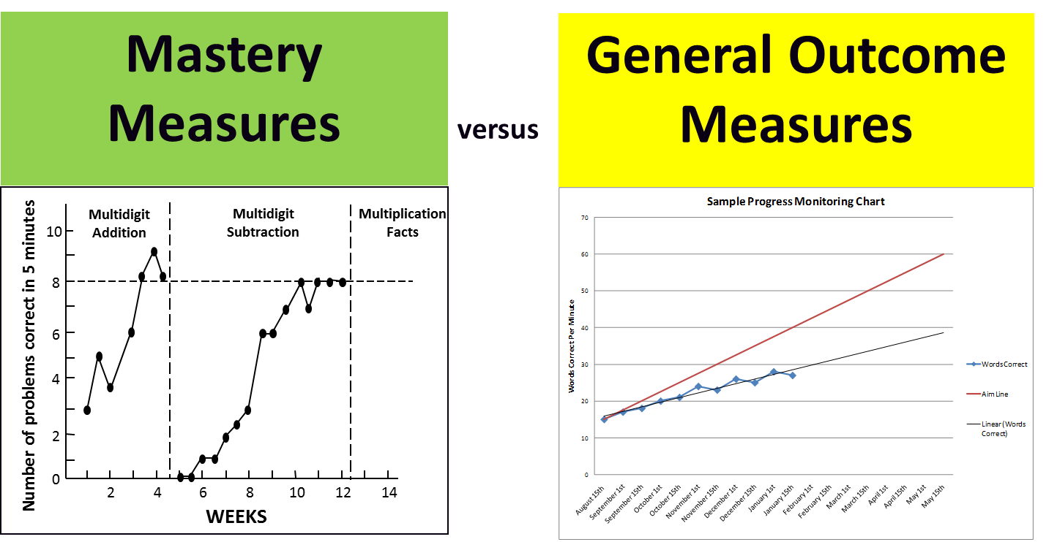
Approaches to Progress Monitoring
What is the difference?
Notes:
Animated slide—click on underlined text to remove red box.
Mastery measures and general outcome measures are two common progress monitoring approaches. One key difference between mastery measures and general outcome measures (GOMs) is the comparability of data longitudinally, or the ability to look at data across time. With GOMs, you can compare the score a student received in May to a score he or she had in September. This cannot be done with mastery measures because each subskill is tracked separately. These subskills do not necessarily correlate well with overall achievement.
This slide is adapted from slide 41 of RTI Implementer Series Module 2: Progress Monitoring (National Center on Response to Intervention, 2012).

Slide 11
Mastery Measures
Describe mastery of a single skill in a series of short-term instructional objectives.
Represent a logical—not an empirical—hierarchy of skills.
Do not reflect maintenance or generalization.
Do not relate well to overall achievement or performance on criterion measures (neither performance on a single mastery measure nor number of objectives mastered).
Notes:
Mastery measures let us know if a student is learning the specific skill currently being taught.
Examples: single-digit subtraction of decimals in the tenths or multidigit addition of decimals to the hundredths place with regrouping, taught and assessed in isolation

Slide 12
General Outcome Measures (GOM)
Reflect overall competence in the annual curriculum.
Incorporate retention and generalization.
Describe an individual student’s long-term growth and development (both current status and rate of development).
Provide a decision-making model for designing and evaluating interventions.
Notes:
GOMs often address the problems associated with mastery measures. They are program independent and can be used with any instructional approach. GOMs can serve as both screening and progress monitoring measures. Many curriculum-based measures (CBMs) are types of GOMs.

Slide 13
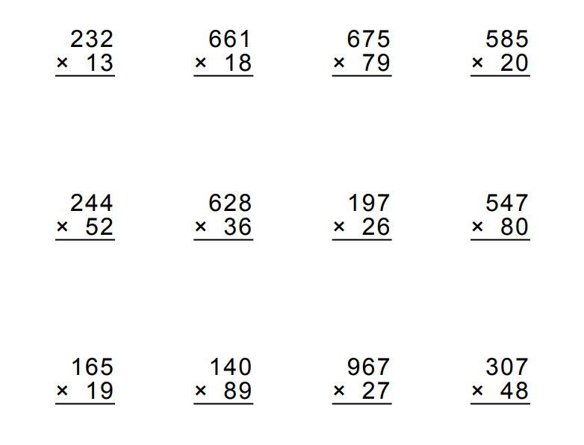
Example of a Mastery Measure:
Multi-digit Multiplication Test*
What makes this mastery measurement?
*This example is for illustrative purposes only.
Notes:
All of the problems are of the same type: addition with regrouping in various place value, not just tens, for example, mastery measures assess only one taught skill at a time.
This slide is adapted from slide 43 of RTI Implementer Series Module 2: Progress Monitoring (National Center on Response to Intervention, 2012).
The source of this CBM probe is http://themathworksheetsite.com/.

Slide 14
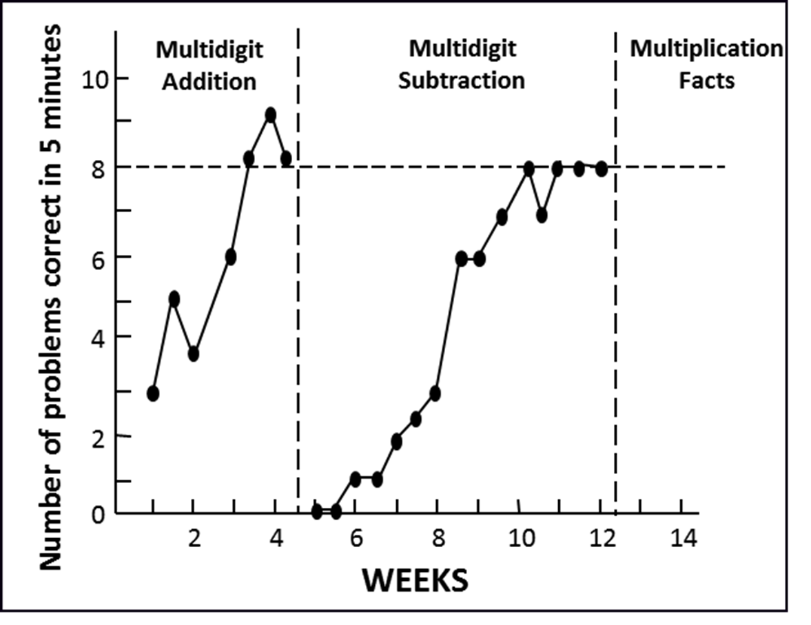
Example of a Mastery Measure Graph
Notes:
If you use mastery measures over a long period of time, you will track different skills. You cannot compare the scores from multidigit subtraction to the scores from multidigit addition to see if a student has improved his or her overall mathematics skills across time.

Slide 15
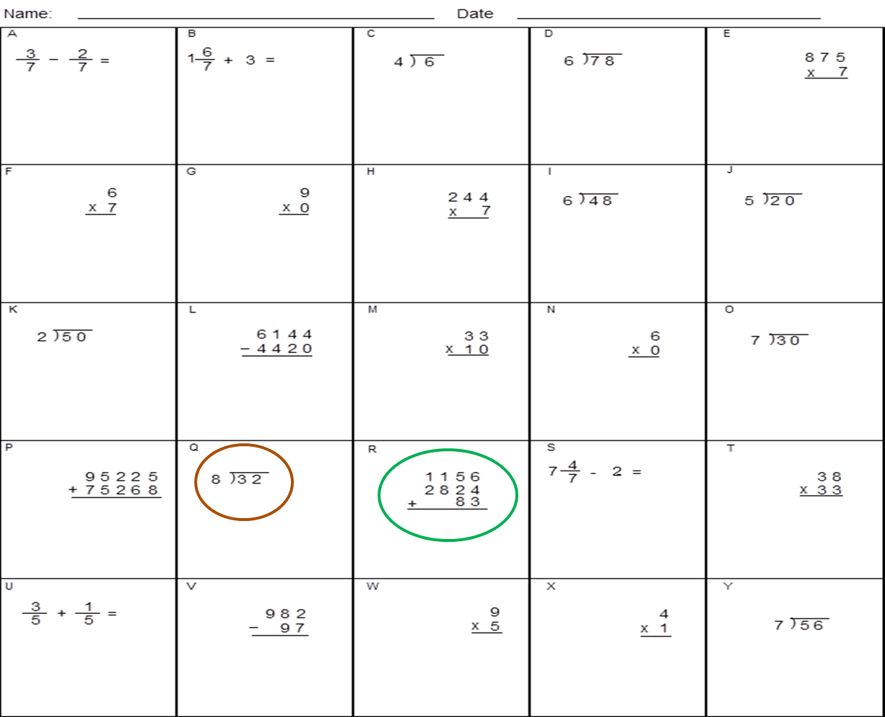
Mathematics Computation GOM Example
What makes this a general outcome measure?
*This example is for illustrative purposes only.
Notes:
A GOM reflects all skills in a yearlong curriculum, with random placement of problem types. By assessing all of the objectives in the curriculum, GOMs will be sensitive to growth as more skills are taught, regardless of the order in which they are taught. GOMs also enable teachers to determine if students are retaining taught skills and generalizing to skills that have not yet been taught.
This slide is adapted from slide 46 of RTI Implementer Series Module 2: Progress Monitoring (National Center on Response to Intervention, 2012).

Slide 16
Common Mathematics Measures
Domain | Measures | Grades
Computation | Single skills computation (e.g., only addition problems, only multiplication problems) Multiskill computation (e.g., multiplication and division) Whole number computation Rational number computation | 1–5
Concepts and applications | Grade-level concepts and applications (e.g., STAR, M-CAP) Including geometry and measurement, data analysis, etc. Word Problem Solving measures for grade-level content | K–5
Notes:
Review slide.
Note: Similar names for measures within a domain reflect the names of different products (by different manufacturers).
In kindergarten, the focus for skills is more on number recognition and understanding that numbers have value. Concepts and applications may include counting, writing numbers, and possibly comparing numbers. Beginning in grade 1, basic computations such as addition and subtraction without regrouping should start.

Slide 17
Considerations For Selecting or Evaluating a Tool
Skills to be measured—age and grade appropriate
Cost and training requirements
Administration and scoring time
Data management
Technical rigor (consider population)
Notes:
Read slide.

Slide 18
Dimensions of Technical Rigor
Reliability
Validity
Evidence of being sensitive to change
Alternate/parallel forms: different versions of the assessment that are of comparable difficulty
Notes:
Explanations for dimensions of technical rigor:
Reliability: Are scores accurate and consistent?
Validity: Does the assessment measure the underlying construct (the targeted skill)?
Sensitive to change: The extent to which a measure reveals long-term improvement, when improvement actually occurs.
Alternate forms: Are the different versions of the assessment of comparable difficulty?

Slide 19
Selecting Progress Monitoring Tools
National Center on Intensive Invention tools charts offer technical ratings and implementation information on assessment and intervention programs commonly used as part of a multi-tiered system of support (MTSS).
Development and maintenance funded by U.S. Office of Special Education Programs (OSEP) since 2004.
Currently housed on the National Center on Intensive Intervention (NCII) website: https://intensiveintervention.org/about-charts-resources
Notes:
Read slide.

Slide 20
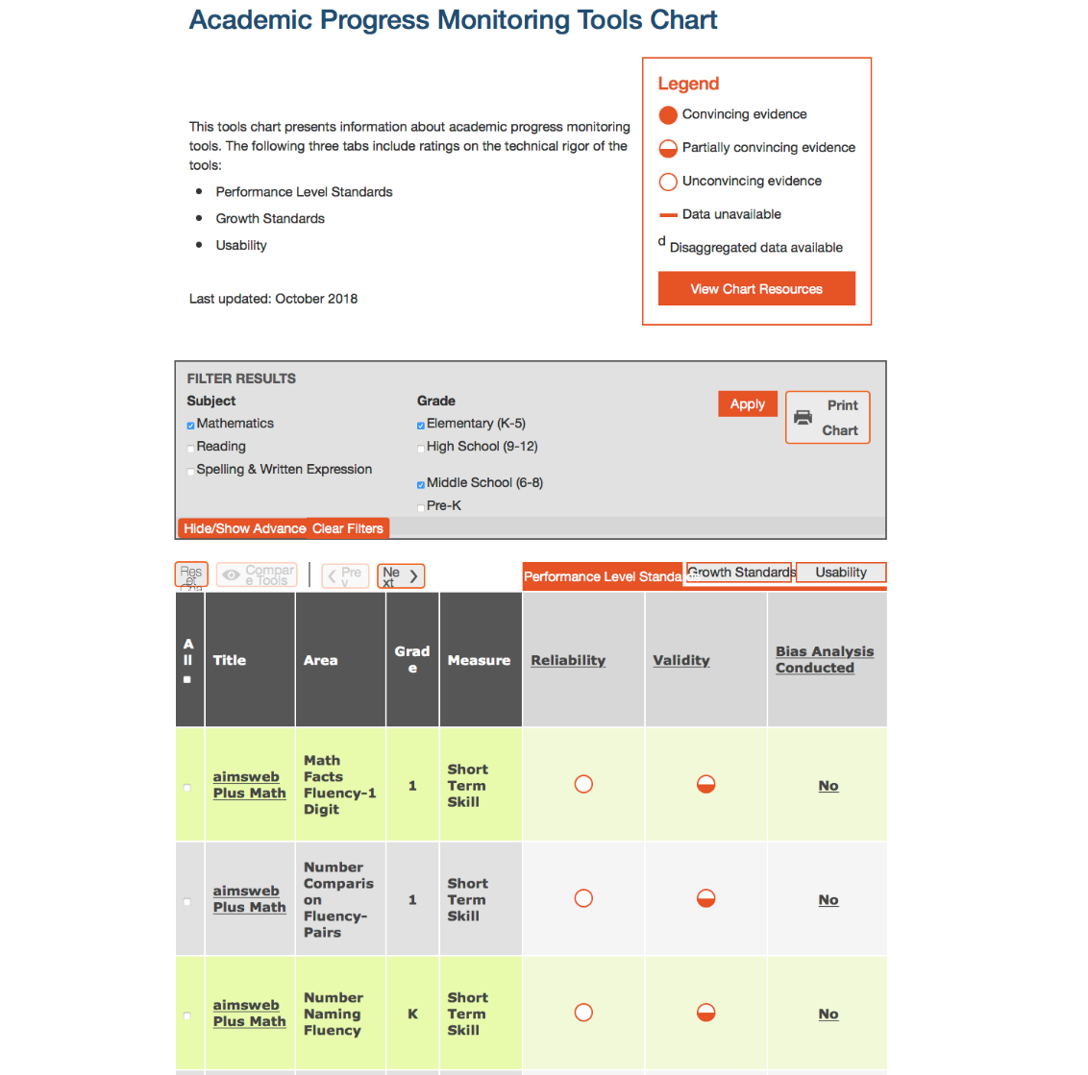
Academic Progress Monitoring Chart
https://charts.intensiveintervention.org/chart/progress-monitoring?field_apm_subject%5B%5D=358&field_apm_grade%5B%5D=355&field_apm_grade%5B%5D=356

Slide 21
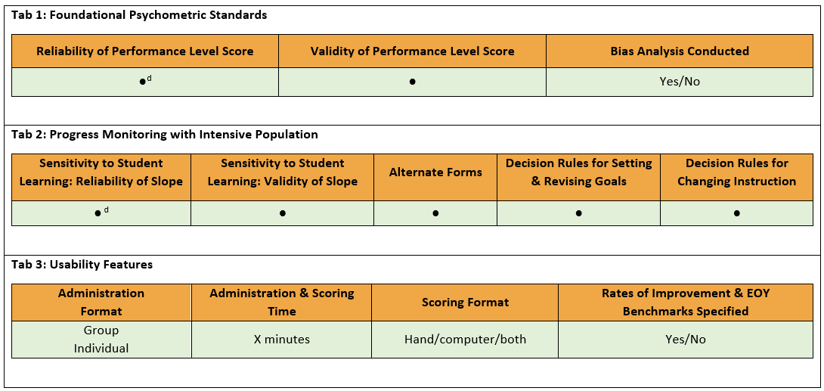
APM Tools Chart: Tab Structure

Slide 22
APM Tools Chart: Tab Structure

Slide 23
APM Tools Chart: Tab Structure

Slide 24
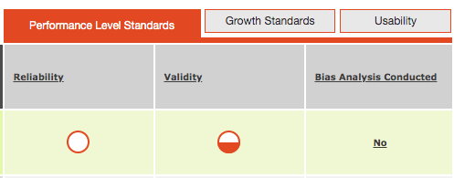
Progress Monitoring Tools: User Tips
Remember: Click on the header for more information about how each of these areas was rated.

Slide 25
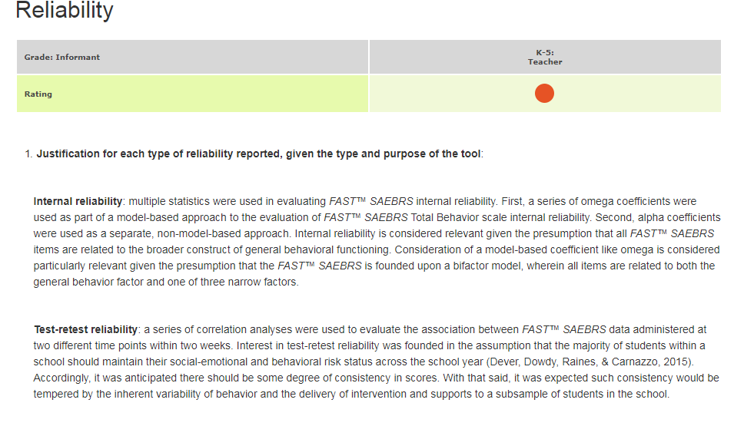
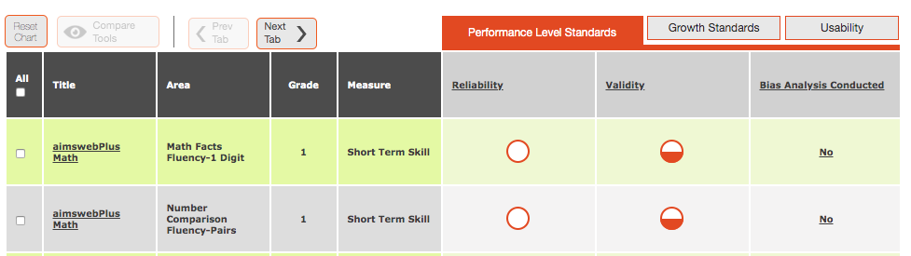
Progress Monitoring Tools:
Dig Deeper Into the Data
Click on the rating bubble to view the additional data used by reviewers to determine the rating.

Slide 26
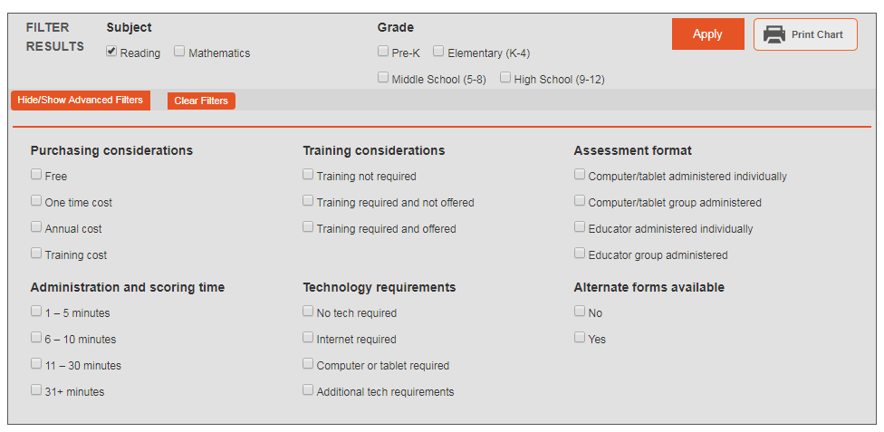
Advanced Filtering
Looking for something specific? Use the advanced filtering to narrow your search.
Get a printable version of the chart.

Slide 27
Making Instructional Decisions for Individual Students
Using progress monitoring data to determine current status, set goals, and evaluate growth
Notes:
Now we will discuss how academic progress monitoring fits into the DBI process and can be used to make instructional decisions for students with intensive needs.
This section is where you should spend the bulk of the instructional time.

Slide 28
Steps for Using Progress Monitoring Data
Establish a baseline.
  For students on IEPs, use baseline for development of present level statements.
Set a goal.
Analyze data to make decisions.
Notes:
Provide audience with Handout 1: Academic Progress Monitoring Overview.
Before we can analyze data to make instructional decisions, we need to use the data we collect to establish a baseline and set a goal. This handout will enable you to reference information about each step as we work through examples.

Slide 29
Step 1: Establish a Baseline
To begin progress monitoring, you need to know a student’s initial skill level.
A stable baseline is important for goal setting.
For students with IEPs, baseline should be used as a component of present level of performance statement.
Baseline options:
  Use the median score of the most recent three probes (if collected in one sitting).
  Use the mean of the most recent three data points (if collected over three sittings).
Notes:
Read slide.

Slide 30
Quick Review: Mean and Median
Mean
Arithmetic average
Sum of all scores divided by number of scores
Median
Middle number in an ordered list
If you have an even number of scores, take the average of the two middle scores.
Notes:
Read slide.

Slide 31
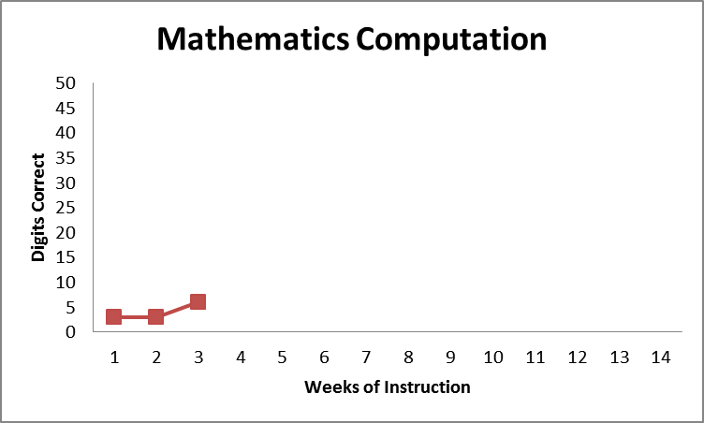
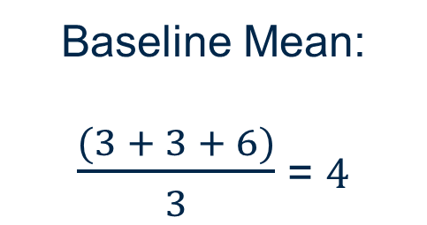
Example: Finding the Baseline Score
Using Means
When baseline assessments are conducted on different days (e.g., three data points over 3 weeks), we use the mean of the most recent three scores (we will use this method in today’s examples).
Baseline Mean:
$\frac{(3 + 3 + 6)}{3}$ = 4
Notes:
Read slide.

Slide 32
Small-Group Discussion: Baseline
Take 5 minutes to discuss the following:
When progress monitoring your students in secondary or intensive intervention, do you have a standard procedure for determining the baseline score?
If your progress monitoring tool has a data system that provides a baseline score, do you know which method is used (mean or median)?
Notes:
Give the audience time to discuss in small groups and then a chance to share or ask questions, as needed.

Slide 33
Step 2: Set Ambitious Goals
There are three approaches to setting goals:
Benchmarking
National norms for weekly ROI
Intra-individual framework
These procedures can, and should, be used to set goals for intervention. They may also be used to determine present levels of performance and goals within an IEP.
Notes:
Read slide.

Slide 34
Option 1: Using Benchmarks
Benchmark: A level of performance on an assessment that is predictive of proficiency
Identify appropriate grade-level benchmark.
    If progress monitoring off-level, use benchmarks for the grade of the assessment being used.
    Make sure the benchmark matches the time frame of the instructional period you want to monitor.
Mark benchmark on student graph.
Draw goal line from baseline to benchmark.
Notes:
Read slide.

Slide 35
Option 1: Setting Goals With Benchmarking (Fall, Winter, Spring)
Grade | Correct Digits per Minute (National) | Computation (M-COMP, AIMSweb) | Concepts and Applications (M-CAP, AIMSweb)
Grade 6 | 35 digits correct per minute | 36, 38, 48 points | 19, 9, 23 points
Grade 7 | 20 digits correct per minute | 42, 43, 51 points | 14, 11, 24 points
Grade 8 | 30 digits correct per minute | 38, 36, 45 points | 16, 6, 24 points
Note. These figures are for illustrative purposes only.
(National Center on Response to Intervention, 2012)
Notes:
Here’s a sample benchmark table. The scores represent the total score on M-COMP and M-CAP from AIMSweb. The scores are at the 75th percentile for fall, winter, and spring.
This table is adapted from slide 91 of RTI Implementer Series Module 2: Progress Monitoring PowerPoint (National Center on Response to Intervention, 2012).

Slide 36
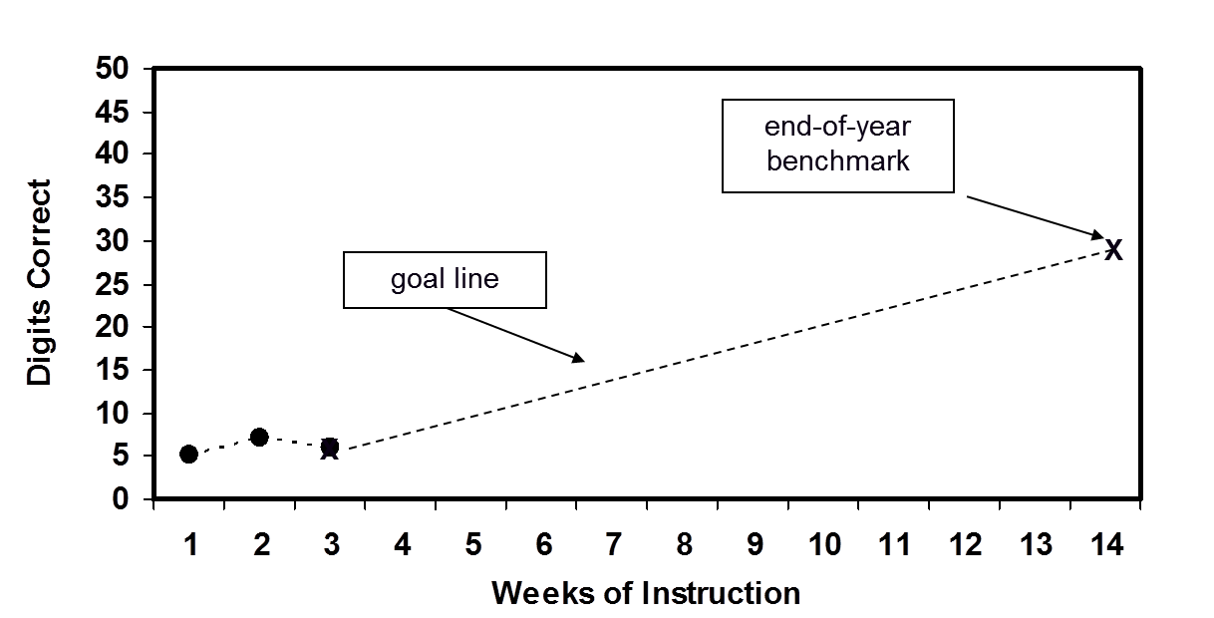
Option 1: Setting Goals With End-of-Year Benchmarking
Sixth-Grade Computation
Notes:
On this graph, the baseline score is marked with an X at the most recent baseline data point. Another X marks the benchmark of 30 digits. The goal line connects these two points.

Slide 37
Discussion: Using Benchmarks
What are the advantages of this approach?
Easy to use when progress monitoring tool provides benchmarks.
Tracks progress toward grade-level expectations.
Can you think of special considerations in using this approach for students with intensive needs?
Goal may not be feasible for students performing far below grade level.
Notes:
Animated slide—click to bring up first set of bullets and then the second set.
Remember to mention the role of the student and the power in student-graphed data, especially for those students with intensive needs.

Slide 38
Using Progress Monitoring Data to Write Present Levels of Performance
Describe concrete, measurable skills that have relevance to overall competence in a domain (e.g., reading, mathematics).
Use valid and reliable assessment tools.
Focus on outcomes:
  What outcomes are desired?
  What do present levels say about a student’s current progress toward meeting those outcomes?
  Compare to peers or proficiency standards.
Notes:
Read slide.

Slide 39
Option 2: Setting Goals With Norms for Weekly Rate of Improvement
Average growth per week (ROI) for a certain measure can be used to calculate a goal:
GOAL = ROI × # Weeks + Baseline Score
# weeks = number of weeks left in the instructional period (when we want the goal to be reached).
Baseline score is calculated using the three most recent data points.
Notes:
Read slide.

Slide 40
Example: Setting Goals With National Norms for Weekly ROI
Grade | Computation CBM—Slope for Correct Digits | Computation CBM—Slope for Points | Concepts and Applications CBM—Slope for Points
6 | .60 | 0.50 | 0.25
7 | .70 | 0.47 | 0.28
8 | .50 | 0.31 | 0.17
Note. These figures are specific to AIMSweb National Norms at the 75th percentile and may change pending further research. This example is used for illustrative purposes only. The American Institutes for Research does not endorse or recommend specific products.
Notes:
Animated slide—click at underlined text to bring up circle.
Here is an example growth chart for middle school mathematics. If we monitor progress with sixth-grade math computation, we would use the chart to identify 0.70 correct digits per week as the typical growth rate.

Slide 41
Example: Setting Goals With National Norms for Weekly ROI
Seventh-grade mathematics computation
Baseline scores: 10, 9, 11 (collected weekly)
Time frame: 10 weeks left in the instructional period
ROI = 0.70
Grade | Computation—ROI for Digits Correct
6 | 0.60
7 | 0.70
8 | 0.50
Notes:
Review slide. Sample workout on next slide.

Slide 42

Example: Setting Goals With National Norms for Weekly ROI
GOAL = ROI $×$ # WEEKS + Baseline Score
GOAL = 0.70 $×$ 10 + 10 = 7 + 10 = 17
10 left in instructional period
Using mean because three points collected over time:
(10 + 9 + 11)/3 =
30/3 = 10
0.70
Baseline
Target growth

Slide 43
Option 2: Setting Goals With National Norms for Weekly ROI
Considerations for using ROI for goal setting:
If a student is behind, matching the ROI norm will maintain the same level of achievement gap yet may still not be appropriate for some students.
Some progress monitoring tools provide recommendations for “ambitious” ROIs.
How might you estimate expected weekly growth if ROI norms are not provided?
  Use local norms.
  Estimate by dividing growth between benchmark periods by the number of weeks of instruction.
Notes:
Additional explanations are provided below. Use as needed.
Norms are established based on what is considered good growth. Growth may vary based on the domain being assessed.
“Realistic” is often considered what students would make given decent instruction. “Ambitious” should, at minimum, be more than the average growth; otherwise, the performance gap will be maintained, not closed. Some progress-monitoring tool publishers have recommendations for using the growth rates they provide. For example, AIMSweb recommends doubling the growth rate found at the percentile rank in which the student currently performs. Using the recommendations from AIMSweb, if a student’s baseline is in the 10th to 25th percentile and the growth rate for students at that performance level is 0.5 digits correct in one minute, then the ambitious growth rate would be 1.0 digits correct in one minute. If 0.5 digits correct were used, the student would be likely to maintain or increase the achievement gap. It is important to contact the publisher to clarify how to best use the growth rates it offers.
In comparing local versus national norms, the benefits of local norms include correlations with state testing outcomes and comparisons within the district or state. Challenges with local norms include small sample size, norms being unavailable, and the potential to lead to lower expectations. For national norms, the benefits include a large sample size and established cut scores, but the challenges include inequities in school resources, which can lead to over- or underidentification.
43

Slide 44
Option 2: Setting Goals With National Norms for Weekly ROI
The benefits of local norms:
  Correlations with state testing outcomes and comparisons within the district or state
Challenges with local norms:
  Small sample size, norms being unavailable, and the potential to lead to lower expectations
For national norms, the benefits are:
  A large sample size and established cut scores
For national norms, the challenges include:
  Inequities in school resources, which can lead to over- or under-identification.
Notes:
Additional explanations are provided below. Use as needed.
Norms are established based on what is considered good growth. Growth may vary based on the domain being assessed.
“Realistic” is often considered what students would make given decent instruction. “Ambitious” should, at minimum, be more than the average growth; otherwise, the performance gap will be maintained, not closed. Some progress-monitoring tool publishers have recommendations for using the growth rates they provide. For example, AIMSweb recommends doubling the growth rate found at the percentile rank in which the student currently performs. Using the recommendations from AIMSweb, if a student’s baseline is in the 10th to 25th percentile and the growth rate for students at that performance level is 0.6 wrc, then the ambitious growth rate would be 1.2 wrc. If 0.6 wrc were used, the student would be likely to maintain or increase the achievement gap. It is important to contact the publisher to clarify how to best use the growth rates it offers.
44

Slide 45
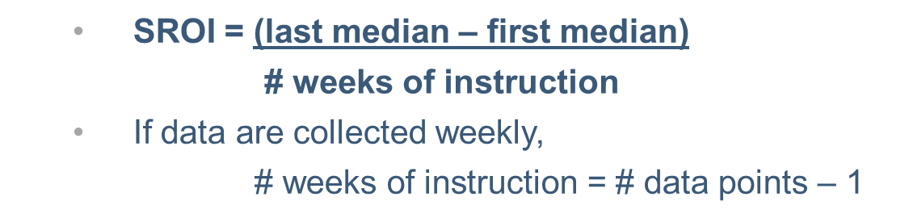
Option 3: Setting Goals With
Intra-individual Framework
Often used for students performing far below grade level or with very low skills, where typical growth rates are not appropriate.
Use the three most recent data points to calculate baseline.
Calculate student’s ROI (SROI) based on at least eight data points. Use software when available (more accurate) or estimate using the following equation:
Notes:
The third option, intra-individual framework, is often used for setting individualized education program (IEP) goals or for those students performing far below grade level. To use this option, identify the weekly rate of improvement for the target student under baseline conditions, using at least eight data points. Because the student’s performance is being compared to his or her previous performance (not a national or local norm), enough data are needed to demonstrate the existing performance level or rate.
Software will provide a more accurate estimate of SROI. When software is not available, SROI can be estimated by hand. This formula represents just one of various approaches. When eight data points are available, the last median will be based on the last three scores, and the first median will be based on the first three scores.

Slide 46
Option 3: Setting Goals With
Intra-individual Framework
Why 1.5?
We know the current SROI is not sufficient to close the achievement gap; we want to increase growth at least by half (× 1.5).
A more ambitious goal may be set if appropriate (e.g., if after several weeks of progress monitoring, the current SROI exceeds the goal SROI).
Never lower the goal!
Notes:
Explanation of formula: SROI is multiplied by 1.5 and the number of weeks left in the instructional period. This product, representing target growth, is then added to the student’s baseline score, based on the three most recent data points, to find the goal.

Slide 47
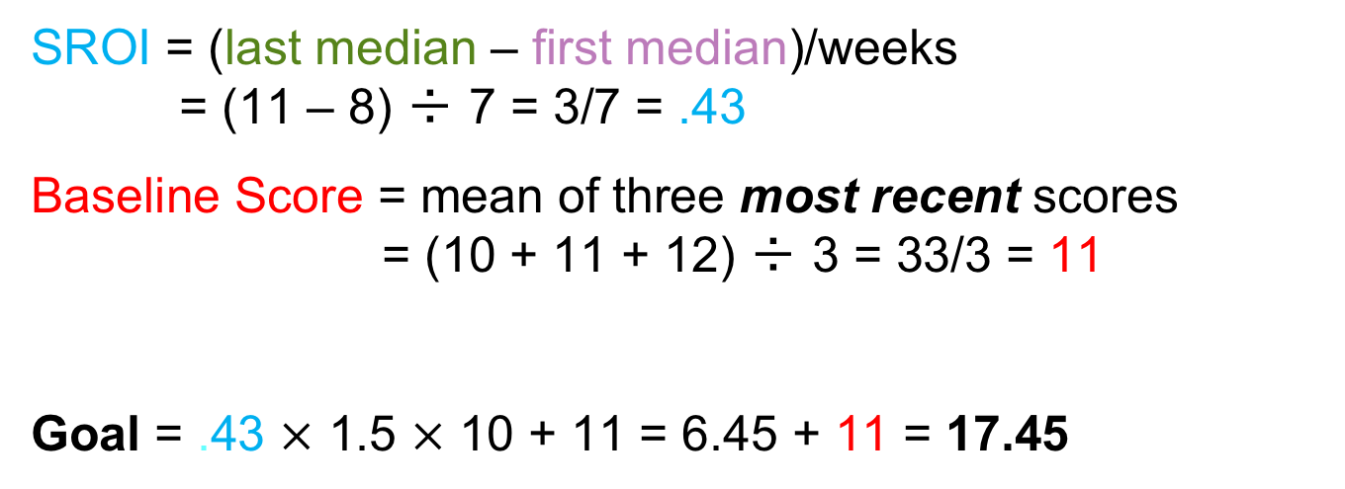
Example: Setting Goals With
Intra-individual Framework
Eight most recent scores (over 7 instructional weeks):
8, 7, 9, 8, 11, 10, 11, 12
Ten weeks left in instructional period
SROI = (last median – first median)/weeks
= (11 – 8) ÷ 7 = 3/7 = .43
Baseline Score = mean of three most recent scores
= (10 + 11 + 12) ÷ 3 = 33/3 = 11
Goal = .43 $×$ 1.5 $×$ 10 + 11 = 6.45 + 11 = 17.45
SROI
Target growth factor
Baseline
Weeks
Notes:
Review slide.

Slide 48
Will Collecting Eight Data Points Delay Important Decisions?
In the previous example, SROI was calculated using eight data points from 7 weeks of instruction.
This does NOT necessarily mean we have to wait
7 weeks to make an instructional decision.
We can use progress monitoring data that we have already collected for this student.
  Draw data from a goal that was set using a different option, such as benchmarks.
  Use data from the preceding year to identify the present level of performance and set the goal.
Notes:
Read slide.

Slide 49
Bringing It Together: Setting an IEP Goal for Andrew

Slide 50
Setting a Goal for Andrew
Let’s work together to set a goal for Andrew using each of the following methods. You can refer to your handout if you’d like.
  Benchmarking
  Weekly ROI norms
  Intra-individual framework
Assume 24 weeks of instruction between now and the end of the school year.
Notes:
This can be an independent activity or group activity in which participants practice what they have learned.
Provide the audience with Handout 2. Give them time to work before bringing up solutions on the following slides.

Slide 51
Describing Present Levels and Choosing a Goal for a Student Who Requires Individualized Planning
Meet Andrew:
Sixth grade
Specific learning disability with eligibility in mathematics calculation
Andrew’s most recent scores on the M-COMP are:
  18, 20, 15
Notes:
Read slide.

Slide 52
Andrew Option #1:
Goal Setting Using Benchmarks
Grade | M-COMP | M-CAP
Grade 6 | M-COMP: 36 points | M-CAP: 19 points
Grade 7 | M-COMP: 42 points | M-CAP: 14 points
Grade 8 | M-COMP: 38 points | M-CAP: 16 points
Which benchmark do we use for Andrew?
Notes:
Click to bring up highlighted box after posing question.
Answer: We use the norms for the level of assessment where we are monitoring. The numbers presented here are for the 75th percentile for the fall.

Slide 53
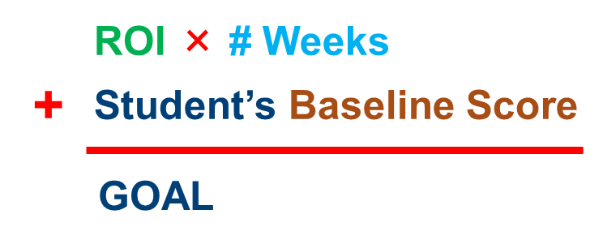
Andrew Option #2:
Weekly ROI Norms
Baseline M-Comp score
(mean of three scores)
(18 + 20 + 15) ÷ 3 = 17.6
0.60 × 24 = 14.4
14.4 + 17.6 = 32
Goal = 32
Grade | ROI
6 | .60
7 | .70
8 | .40
Notes:
Animated slide—click on underlined text.
To review, this is the formula for calculating a goal based on ROI norms.
Take the baseline for the first three scores: 18, 20, 15 = 53 ÷ 3 (first median) = 17.6.
Take the sixth-grade norms for this student (out-of-level assessment), .60, and multiply those by 24 for the remaining weeks of instruction; round to 17.6 .
Take 14.4 and add the baseline mean (17.6); this equals the ROI norms of 32.

Slide 54
Andrew Option #3:
Intra-individual Framework
  (Eight scores over 7 weeks) for the MCOMP are:
  18, 20, 15, 17, 16, 19, 20, 19
  First Median =
  (18, 20, 15) = 18
  Second Median =
  (16,19, 20, 19) = 19
  Baseline (recent 3) = 19.3
SROI = (19 – 18) ÷ 7 = 0.14
# Weeks = 24
0.14 × 1.5 × 24 + 19.3 = 24.34
Goal = 24.34 or 24.5
Notes:
Note: Rounded-up for goals to be more ambitious.
Animated slide—click on underlined text. Reminder: SROI = (third median – first median) ÷ weeks of instruction.
This is the formula for calculating Andrew’s goal using the intra-individual framework. First, we need to calculate Andrew’s SROI. We take the median of his first three scores (slide 57), which is 18, and subtract the median of the second four scores, which is 19.
We then divide by 7, the number of weeks of instruction during this baseline period, to find his SROI of 0.14. The # Weeks is the 24 weeks of instruction left in the school year.
Andrew’s baseline score is the mean of his most recent three scores. Now that we have all the needed pieces, we multiply his SROI by 1.5 and 24 weeks and then add his recent baseline score of 19.3. We round to find the goal, which is 24 cdpm.

Slide 55
Choosing a Goal for Andrew
The three methods resulted in different M-COMP goals:
Benchmarking: 36 points (sixth grade)
ROI norms: 32 points
Intra-individual framework: 24 points
Things to consider...
How does Andrew’s intra-individual norms compare to national or local norms for ROI?
Do we know his history of mathematics growth in previous school years?
What goal is sufficiently ambitious?

Slide 56
Choosing an Option: National Norms
Pros
Ambitious
Goal puts student on track to close achievement gap
Cons
May be unrealistic if student is very far behind
Recommendation: Use national norms if a student is close to grade level.
Notes:
Animated slide—click to bring up box after reviewing pros and cons.

Slide 57
Choosing an Option: ROI
Pros
Fairly ambitious
Cons
May not close the gap with peers (may need higher-than-normal ROI to reach next benchmark) and may set unrealistic expectations
Recommendation: Use ROI if a student can learn at a typical rate but the benchmark is too high.
Notes:
Animated slide—click to bring up box after reviewing pros and cons.

Slide 58
Choosing an Option:
Intra-individual Framework
Pros (may be appropriate if…)
Student is performing well below grade-level peers
ROI has been persistently very low
It is informed by the student’s prior performance
Cons
May result in a lower rate of growth than the ROI or benchmark options; however, goals can always be raised
May not close the gap with peers
Recommendation:
Data or prior experience suggest other approaches unlikely to be appropriate or realistic.
Revisit data frequently, increasing goal if possible.
Notes:
Animated slide—click to bring up box after reviewing pros and cons.

Slide 59
Team Discussion:
Andrew—Choosing a Goal
Which framework should we use to develop a goal for Andrew?
The intra-individual framework may be most appropriate for Andrew, but it may not be ambitious enough.
If he exceeds his goal, it can be raised; Andrew’s teacher should watch this closely.
Notes:
Read slide.

Slide 60
Andrew: Present Level of Performance
Take 5: Given what you know about Andrew, work individually or as a group and write a statement of present level of academic achievement and functional performance (PLAAFP) that could be used for an IEP.
It is important always to note that present levels should:
Describe the student’s needs.
Serve as a baseline to measure subsequent performance.
Inform annual goals.
Sample PLAAFP: Andrew currently scores an average of 18 points on the sixth-grade M-COMP. The grade-level benchmark is 36 points.
More on PLAAFP can be found at the IRIS Center.
Notes:
Read slide.

Slide 61
Andrew: Sample IEP Goal
IEP Goal: Andrew will improve his score on the M-Comp from an average of 18 points to a score of 32 points by the next reporting period.
Optional Short-Term Objectives
Time Frame | Target Score | Gain Needed
Objective 1 | 23 points | 5 points
Objective 2 | 28 points | 5 points
Reporting Period | 32 points | 4 points
Goals like these can be used for present levels of performance, in an IEP, or for students receiving intervention.
Notes:
Read slide.

Slide 62
Step 3: Analyzing Data to Make
Intervention Decisions
Progress monitoring data help us decide when instructional changes need to be made.
  If a student is not sufficiently responding to the standardized secondary platform, begin the DBI process.
  If the response to individualized intervention is not adequate, make new adaptations or change the intervention.
Notes:
Progress monitoring data help us decide when a change needs to be made but not necessarily what changes should be made (use diagnostic assessment to identify instructional needs).
Note: Informal academic diagnostic assessment will be addressed in a subsequent module.

Slide 63
Quick Review: DBI Process
Notes:
Analyzing the data will help us determine if a student is responsive or not, which will tell us if we should continue with the current intervention or make a change.

Slide 64
How Much Data Do I Need to Make a Good Decision?
As the number of data points increases, the effects of measurement error on the trend line decrease.
Christ and Silberglitt (2007) recommended six to nine data points.
More frequent progress monitoring enables instructional decisions to be made sooner.
Recommend weekly assessment for intensive interventions and students in special education.
Notes:
Read slide.

Slide 65
Method 1: Four-Point Rule
After six data points have been collected, examine the four most recent data points.
If all four are above the goal line, increase the goal.
If all four are below the goal line, make an instructional change.
If the four data points are both above and below the goal line, keep collecting data until the four-point rule can be applied (or consider trend analysis—coming up).
Note: Many software programs will do this for you.
Notes:
Read slide.

Slide 66
Practicing the Four-Point Rule
The next two slides show graphed data for students in our secondary intervention platform.
For each student, do the data suggest a need for diagnostic assessment and individualized intervention?
Notes:
Read slide.

Slide 67
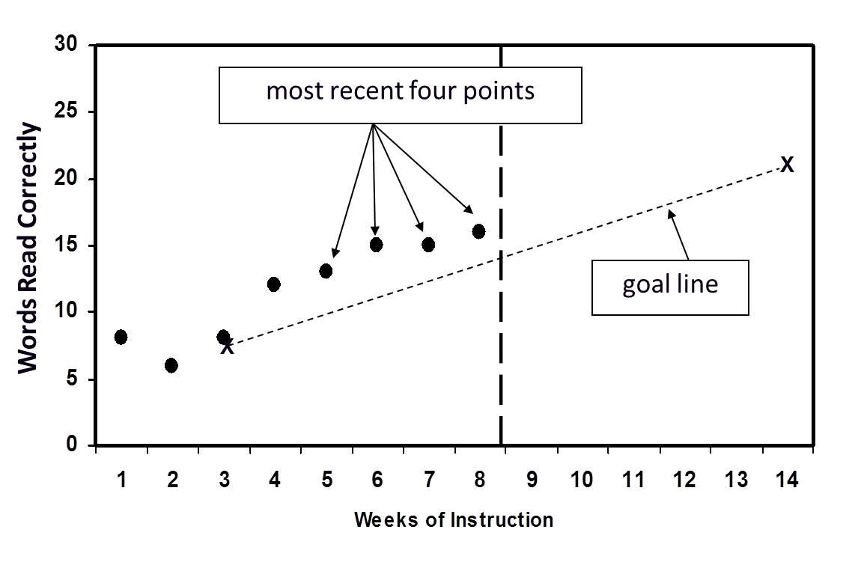
Practicing the Four-Point Rule
Correct Digits
Notes:
All of the most recent four data points were above the goal line. This suggests that we should increase the goal. If the student reaches the grade-level benchmark, we may consider reducing the intensity of her supports.

Slide 68
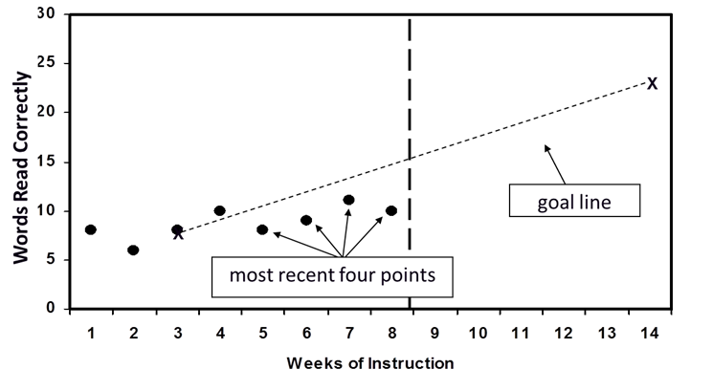
Practicing the Four-Point Rule
Correct Digits
Mandy
Notes:
Mandy’s four most recent scores are below the goal line. Therefore, the teacher needs to change her instructional program. The end-of-year performance goal and goal line never decrease; they can increase only. The instructional program should be tailored to bring Mandy’s scores up so they match or surpass the goal line.
Discussion: The advantage of the four-point rule is that it’s easy to do because it doesn’t require calculating a trend line. The disadvantage is that it is not very sensitive. An outlier score could delay making a decision by preventing four consecutive scores falling above or below the goal line.

Slide 69
Method 2: Decision Rules Based on the Trend Line
After six to nine data points have been collected:
  Calculate the trend of current performance (by hand or
  with software).
  Compare to the goal line.
If the student’s trend line is steeper than the goal line, increase the goal.
If the student’s trend line is flatter than the goal line, make a change to the intervention.
If the student’s trend line and the goal line are the same, no changes need to be made.
Notes:
Read slide.

Slide 70
Practicing Trend-Line Analysis
The following slides show graphs for two students who had the same first three scores and goal lines.
However, their later scores are different, resulting in different trend lines.
Based on the different trend lines, what instructional decisions would you make for each student?
Notes:
Read slide.

Slide 71
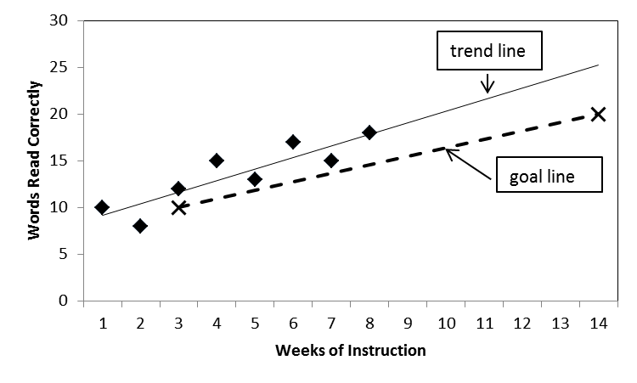
Practicing Trend-Line Analysis
Correct Digits
Mario
Notes:
Mario’s trend line is above the goal line. This suggests that we should increase his goal. If he reaches the grade-level benchmark, we may consider reducing the intensity of his supports.
Note: Trend lines are often calculated using software. For drawing trend lines by hand, please see the RTI Implementer Series Module 2: Progress Monitoring (National Center on Response to Intervention, 2012).

Slide 72
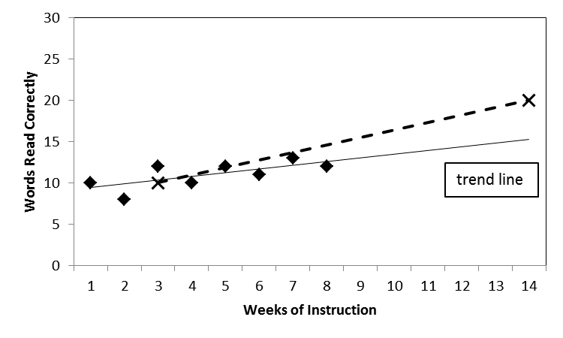
Practicing Trend-Line Analysis
Correct Digits
Jared
Notes:
Jared’s trend line is below and flatter than the goal line, so an instructional change is needed.

Slide 73
Method 3: Combined Decision Rule
After at least six data weekly points, interpret data
each week:
With four consecutive data points above or below, increase goal or change program
If you have eight weekly points without a decision (since the last goal increase or program change), continue with four-point decision making, but if that doesn’t produce
a decision:
Draw a trend line each week to determine if the trend line provides the basis for a decision (if the trend line is steeper/flatter than the goal line, increase the goal or change the program).
Notes:
After at least six data weekly points, interpret data each week: (1) With four consecutive data points above or below, increase the goal or change the program; (2) If you have eight weekly points without a decision (since the last goal increase or program change), continue with four-point decision making, but if that doesn’t produce a decision, draw a trend line each week to determine if the trend line provides the basis for a decision (if the trend line is steeper/flatter than the goal line, increase the goal or change the program).

Slide 74
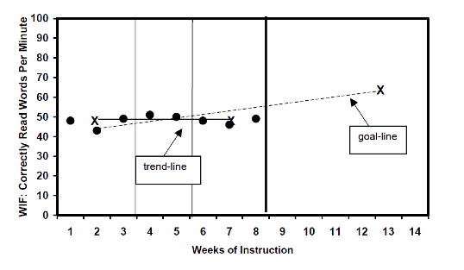
Example: Combined Decision Rule
Notes:
Jared’s four most recent points are not all below the goal line; however, the trend line is below and flatter than the goal line, so an instructional change is needed.
After at least six data weekly points, interpret data each week: (1) With four consecutive data points above or below, increase the goal or change the program; (2) If you have eight weekly points without a decision (since the last goal increase or program change), continue with four-point decision making, but if that doesn’t produce a decision, draw a trend line each week to determine if the trend line provides the basis for a decision (if the trend line is steeper/flatter than the goal line, increase the goal or change the program).

Slide 75
Additional Considerations and Summary
Notes:
Now we will discuss additional considerations for progress monitoring for individual students with certain characteristics.

Slide 76
Should We Ever Assess Off-Level…?
Consider the Purpose of the Assessment
Screening to identify students at risk for poor learning outcomes should occur at grade level because it serves the following purposes:
Determines students’ response to grade-level core instruction.
Assesses performance relative to grade-level expectations.
Provides schoolwide data regarding the percentage of students in each grade level who are at or below benchmarks.
Notes:
Read slide.

Slide 77
Should We Ever Assess Off-Level…?
Consider the Purpose of the Assessment
Progress monitoring should be done at grade level when possible, but…
  if a student’s performance is well below grade-level expectations, grade-level probes are unlikely to be sensitive to growth.
  Off-level assessment may be warranted in these cases.
Notes:
Read slide.

Slide 78
How Can I Confirm or Augment Data
Collected With General Outcome Measures?
In some cases, particularly when working with older students, it may be worthwhile to augment traditional progress monitoring tools.
  In mathematics, we may want to investigate strategy use to understand students’ errors, mathematical thinking, or low fluency.
Brief interviews can help corroborate progress monitoring data or gain new information.
Notes:
Read slide.

Slide 79
Sample Interview Questions to Augment Mathematics Progress Monitoring Data
How did you solve the problem? What was your strategy?
  What did you do first? Next?
Why did you choose this strategy?
Is there another strategy that you could have used?
Can you give me an example of another type of problem for which you could use the same steps or strategy?
Notes:
Read slide.

Slide 80
Optional Practice: Asking Students
About Strategies
The average temperature of the ocean is 62.5˚F. The average length of a humpback whale is 13.9 meters, while the average length of a killer whale is 6.72 meters. How much longer is the humpback whale than the killer whale?
Notes:
Directions:
Find a partner or a small group.
Assign one person to be the teacher and another to be the student.
The teacher should try to find out how the student arrived at his or her answer to this worksheet problem.

Slide 81
Optional Practice: Asking Students About Strategies
Discussion questions:
What types of questions did the teacher ask the student?
How might you vary your questions based on the type of mathematics problem or by student characteristics?
What skills did the student need to be able to solve this problem?
What terminology might the student need to explain how to solve this problem?
Notes:
Discuss these questions in your group. If time allows, discuss as a large group.
Sample answers:
Examples could include the following:
What strategy did you use to solve this problem?
How did you know which numbers to use?
How did you identify extra information? How did you know it was not important?
How did you find this answer?
How do you know this is the answer? For older students, justify the answer or prove that the answer is correct.
Why do you think this is right?
Some questions might include specific terminology for a certain type of problem or focus on a specific step in a problem-solving strategy. Complexity of the question content and language may vary based on student age and skills.
Possible skills needed/steps to perform:
Read problem.
Identify unit and important numbers.
Read graph labels.
Identify bar graph quantities.
Identify subtraction as the operation to answer the question.
Correctly set up the subtraction problem based on the information in the problem and the graph.
Bar graph, number/amount/quantity, subtract, difference, more than, strategy

Slide 82
In Summary
Progress monitoring data help us do the following:
  Decide which students need DBI.
  Determine a student’s response to an individualized intervention, deciding when instructional changes need to be made.
  Write strong, current levels of performance, goals, and objectives for IEPs or other individualized instructional planning.
Notes:
Read slide.

Slide 83
Quick Quiz
What type of assessment is progress monitoring (summative, formative, or diagnostic)?
Identify at least one challenge with mastery measurement that the GOM approach to progress monitoring addresses.
Which goal-setting method might you use for students performing well below their peers?
Which decision rule is more sensitive to change—the four-point method or trend-line analysis?
Notes:
Give the audience time to think about questions and then review as a group.
Answers:
Formative
Generalization, retention, comparing scores across time (across multiple skills)
Intra-individual framework
Trend line

Slide 84

Questions and Discussion
Photo by Jon Tyson on Unsplash

Slide 85
References
Bangert-Drowns, R. L., Kulik, J. A., & Kulik, C.-L. C. (1991). Effects of frequent classroom testing. Journal of Educational Research, 85,
89–99.
Christ, T. J., & Silberglitt, B. (2007). Estimates of the standard error of measurement for curriculum-based measures of oral reading fluency. School Psychology Review, 36, 130–146.
Fuchs, L. S., & Fuchs, D. (1986). Effects of systematic formative evaluation: A meta-analysis. Exceptional Children, 53(3), 199–208.
Fuchs, L. S., & Fuchs, D. (2007). Using CBM for progress monitoring in reading. Washington, DC: National Center on Student Progress Monitoring. Retrieved from http://www.studentprogress.org/summer_institute/2007/Intro%20reading/IntroReading_Manual_2007.pdf

Slide 86
References
National Center on Intensive Intervention. (2013). Data-based individualization: A framework for intensive intervention. Washington, DC: Office of Special Education, U.S. Department of Education. Retrieved from http://www.intensiveintervention.org/resource/data-based-individualization-framework-intensive-intervention
National Center on Response to Intervention. (2012). RTI implementer series module 2: Progress monitoring [PowerPoint presentation]. Washington, DC: Author. Retrieved from http://www.rti4success.org/resourcetype/rti-implementer-series-module-2-progress-monitoring

Slide 87
References
National Center on Response to Intervention (2013). Screening briefs series—Brief #3: Predicting students at risk for reading and mathematics difficulties. Washington, DC: U.S. Department of Education, Office of Special Education Programs, National Center on Response to Intervention. Retrieved from http://www.rti4success.org/pdf/RTI%20Screening%20Brief3-Predicting%20Students.pdf
National Center on Student Progress Monitoring [n.d.]. Introduction to using curriculum-based measurement for progress monitoring in math [PowerPoint presentation]. Washington, DC: Author. Retrieved from http://www.studentprogress.org/library/Webinars.asp#PMMath
Scriven, M. (1991). Evaluation thesaurus (4th ed.). Newbury Park, CA: SAGE Publications.

Slide 88
References
Stecker, P., Sáenz, L, & Lemons, C. (2007). Introduction to using CBM for progress monitoring in reading [PowerPoint presentation]. 2007 Summer Institute on Progress Monitoring. Washington DC: National Center on Student Progress Monitoring. Retrieved from http://www.studentprogress.org/weblibrary.asp#cbm_intro

Slide 89
Disclaimer
This module was produced under the U.S. Department of Education, Office of Special Education Programs, Award No. H326Q110005 and adapted under the Investing in Innovation Fund (i3), U.S. Department of Education, Award No. U411C140029.
The views expressed herein do not necessarily represent the positions or polices of the U.S. Department of Education. No official endorsement by the U.S. Department of Education of any product, commodity, service, or enterprise mentioned in this website is intended or should be inferred.

Slide 90
Address
1000 Thomas Jefferson Street NW
Washington, DC 20007-3835

